Slide 1
DATA EXPLORATION IN Google Earth Engine Francisca Ameley Armah faarmah@ug.edu.gh Centre For Remote Sensing and Geographic Information Services (CERSGIS)
Accra, Ghana
September, 2021

Slide 2
Basic Concepts in GEE

Slide 3
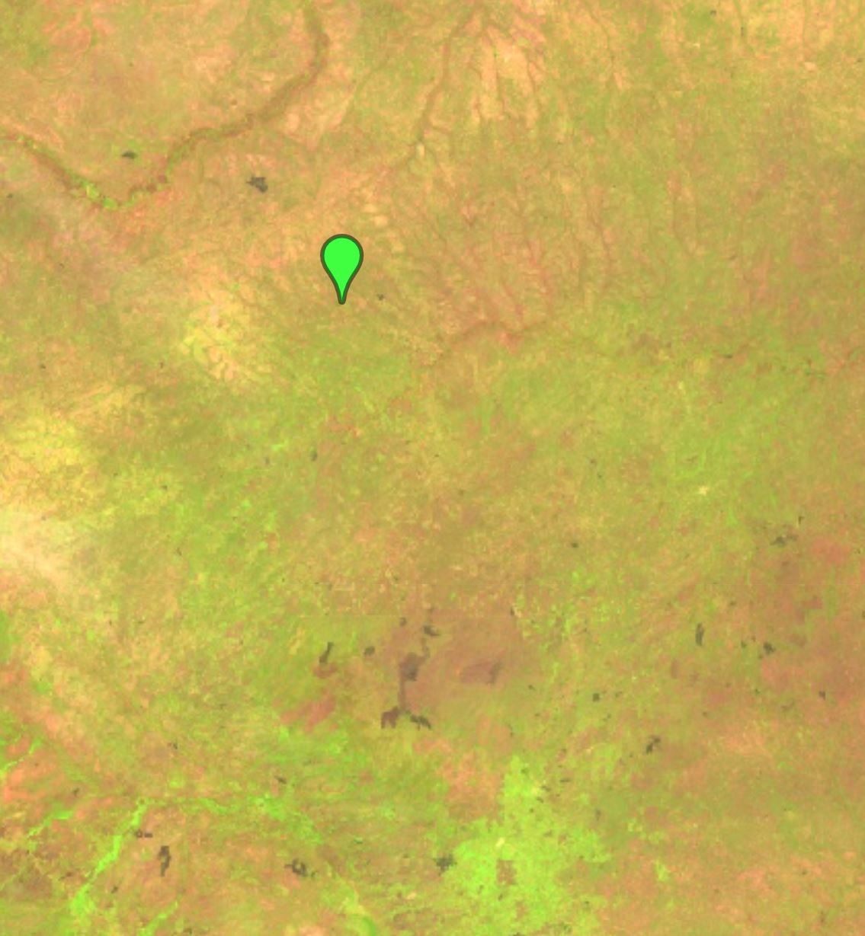
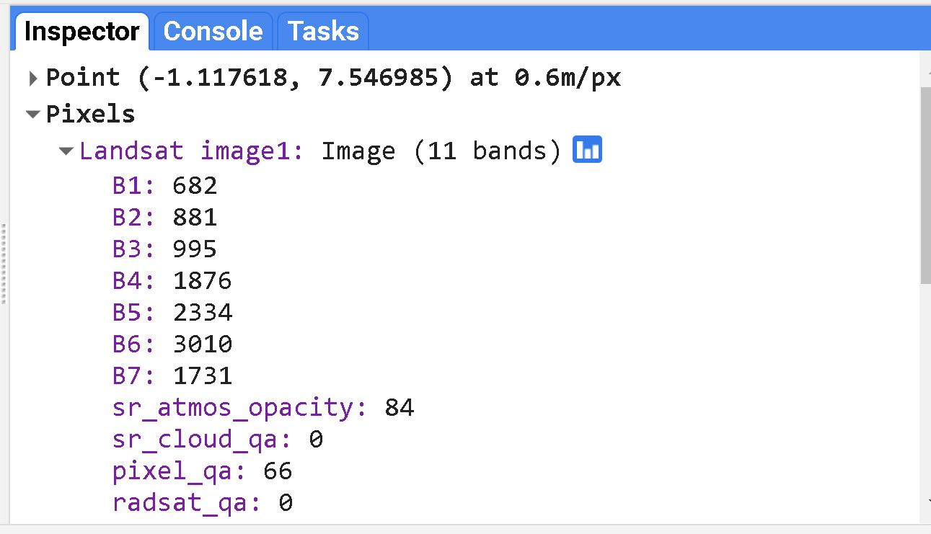
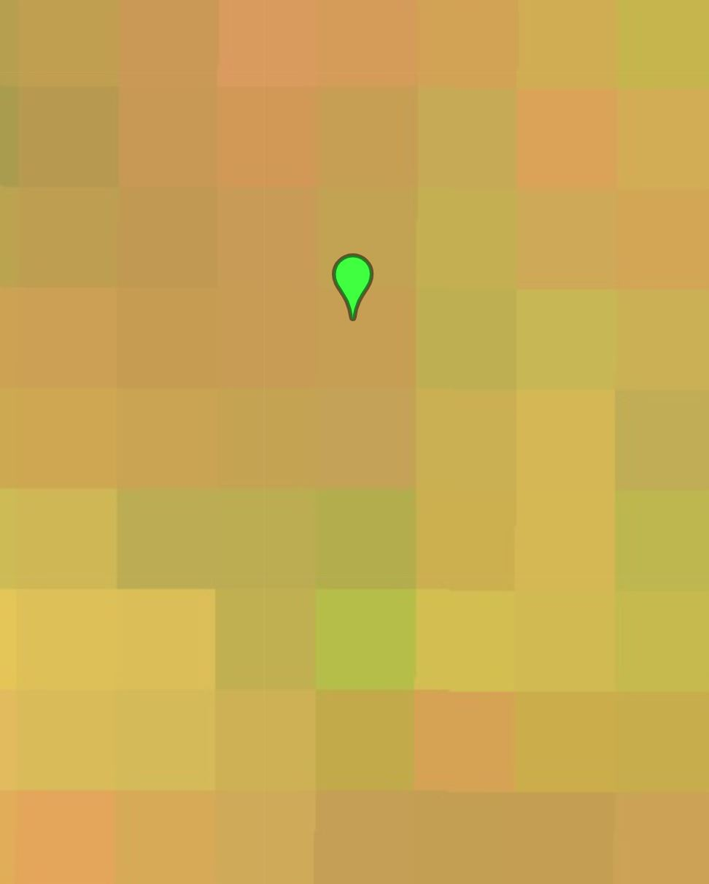
Image
An Image comprises of a two dimensional array of individual picture elements called pixels arranged in columns and rows
Each pixel represents an area on the Earth's surface, which has an intensity value, and a location address in the two dimensional image

Slide 4
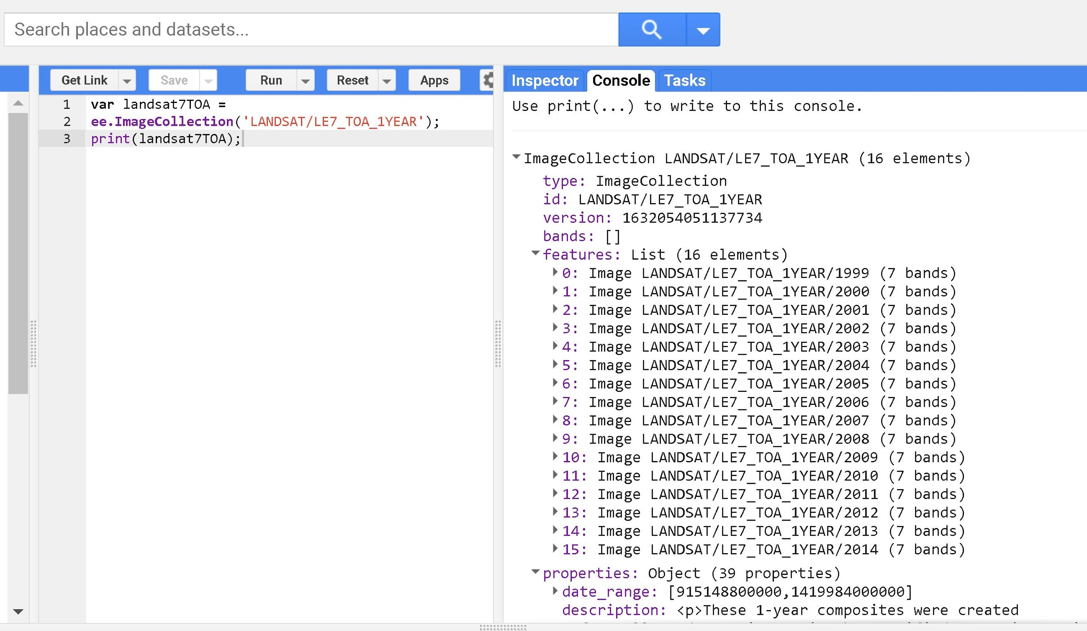
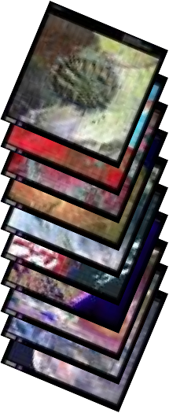
Image Collection
An Image Collection is a stack of images.
For instance a collection of all Landsat 7 images in a given time period
Each image collection has an ID
.

Slide 5
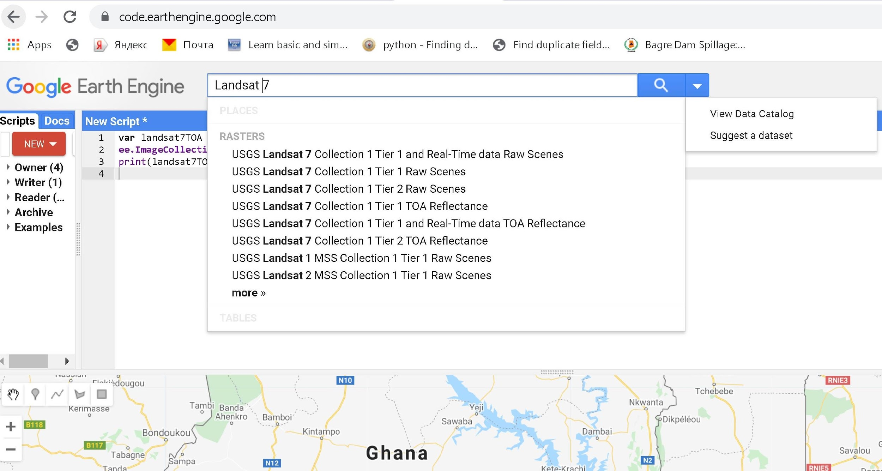
Import an Image or Image Collection
This can be done in two ways:
Use the search button and add the image to a defined workspace
Using the image ID
Var Landsat8=ee.ImageCollection('LANDSAT/LC8_L1T_TOA')
where 'LANDSAT/LC8_L1T_TOA' is the ID

Slide 6
Display or image visualization - 1
Requires visualization parameters
Uses the Function Map.addLayer(image,{visualization parameters},’name’) where the curly brackets {} contain the visualization parameters
Color palette
Example : palette: ['00FFFF', '0000FF'] or palette: [‘red', ‘green', 'blue'] (used for single-band images only)
Bands
Example : 'bands': ['B4', 'B3', 'B2'] (normally a list of three band names to be mapped to RGB
Image stretch parameters
Example : min: 0.0, max:0.3 (used to stretch the image for better visualization)
Map.addLayer(image,{ visualization paramerters},’name’);

Slide 7
Display or image visualization - 2
The function Map.setCenter() is used to sets the viewport to a specific location and zoom level
Example :
var landsat7TOA2014 = ee.Image('LANDSAT/LE7_TOA_1YEAR/2014');
Map.addLayer(ee.Image('LANDSAT/LE7_TOA_1YEAR/2014'),{'bands':['B4', 'B3','B2'],},'Landsat7 2014');
Map.setCenter(-0.411, 6.469,7), where ‘’ -0.411, 6.469” is location and 7 the zoom level

Slide 8
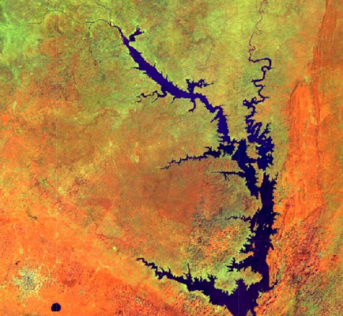
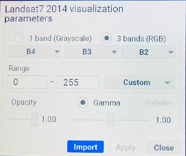
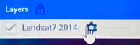
Display or image visualization - 3
After displaying the image you can further manipulate the visualization parameters by using the settings of the image layer.
After manipulating the visualization parameters

Slide 9
Run Script
Visualization of Image/Image Collection

Slide 10
Image Processing - 1
Filter by metadata: Query the image metadata using filters such as ee.Filter.eq(), ee.Filter.lt() etc. You can filter by path/row values, orbit number or cloud cover
Example. var filtered1 = s2.filter(ee.Filter.lt('CLOUDY_PIXEL_PERCENTAGE', 30))
Filter by date: Select images in a particular date range using filters such as ee.Filter.date()
Example. ee.Filter.date('2019-01-01', '2020-01-01'))
Filter by location: Subset an image with a bounding box, or any user-defined geometry using the ee.Filter.bounds()
Example. .filter(ee.Filter.bounds(geometry))
Filter by cloud PERCENTAGE: This function filters out images with less clouds using the function ee.Filter.lt()
Example. .filter(ee.Filter.lt('CLOUDY_PIXEL_PERCENTAGE', 30))

Slide 11
Image Processing - 2
Concatenating filters with the dot (.) notation
Example
//importing geometry
var geometry= ee.Geometry.point([-3.02,6.67]);
// importing the image collection
var s2 = ee.ImageCollection("COPERNICUS/S2");
// applying the filtering functions
var filtered = s2.filter(ee.Filter.lt('CLOUDY_PIXEL_PERCENTAGE', 30))
.filter(ee.Filter.date('2019-01-01', '2020-01-01'))
.filter(ee.Filter.bounds(geometry))
print(filtered);

Slide 12
Image Processing - 3
Mosaicking: the Function .mosaic() is used on a ImageCollection to create a image mosaics
Image Compositing: application of reduce Functions
Example:
var filtered = s2.filter(ee.Filter.lt('CLOUDY_PIXEL_PERCENTAGE', 30))
.filter(ee.Filter.date('2019-01-01', '2020-01-01'))
.filter(ee.Filter.bounds(geometry))
print(filtered);
// mosaicking the image collection
var mosaic = filtered.mosaic()
// Compositing using the median reducer
var medianComposite = filtered.median();

Slide 13
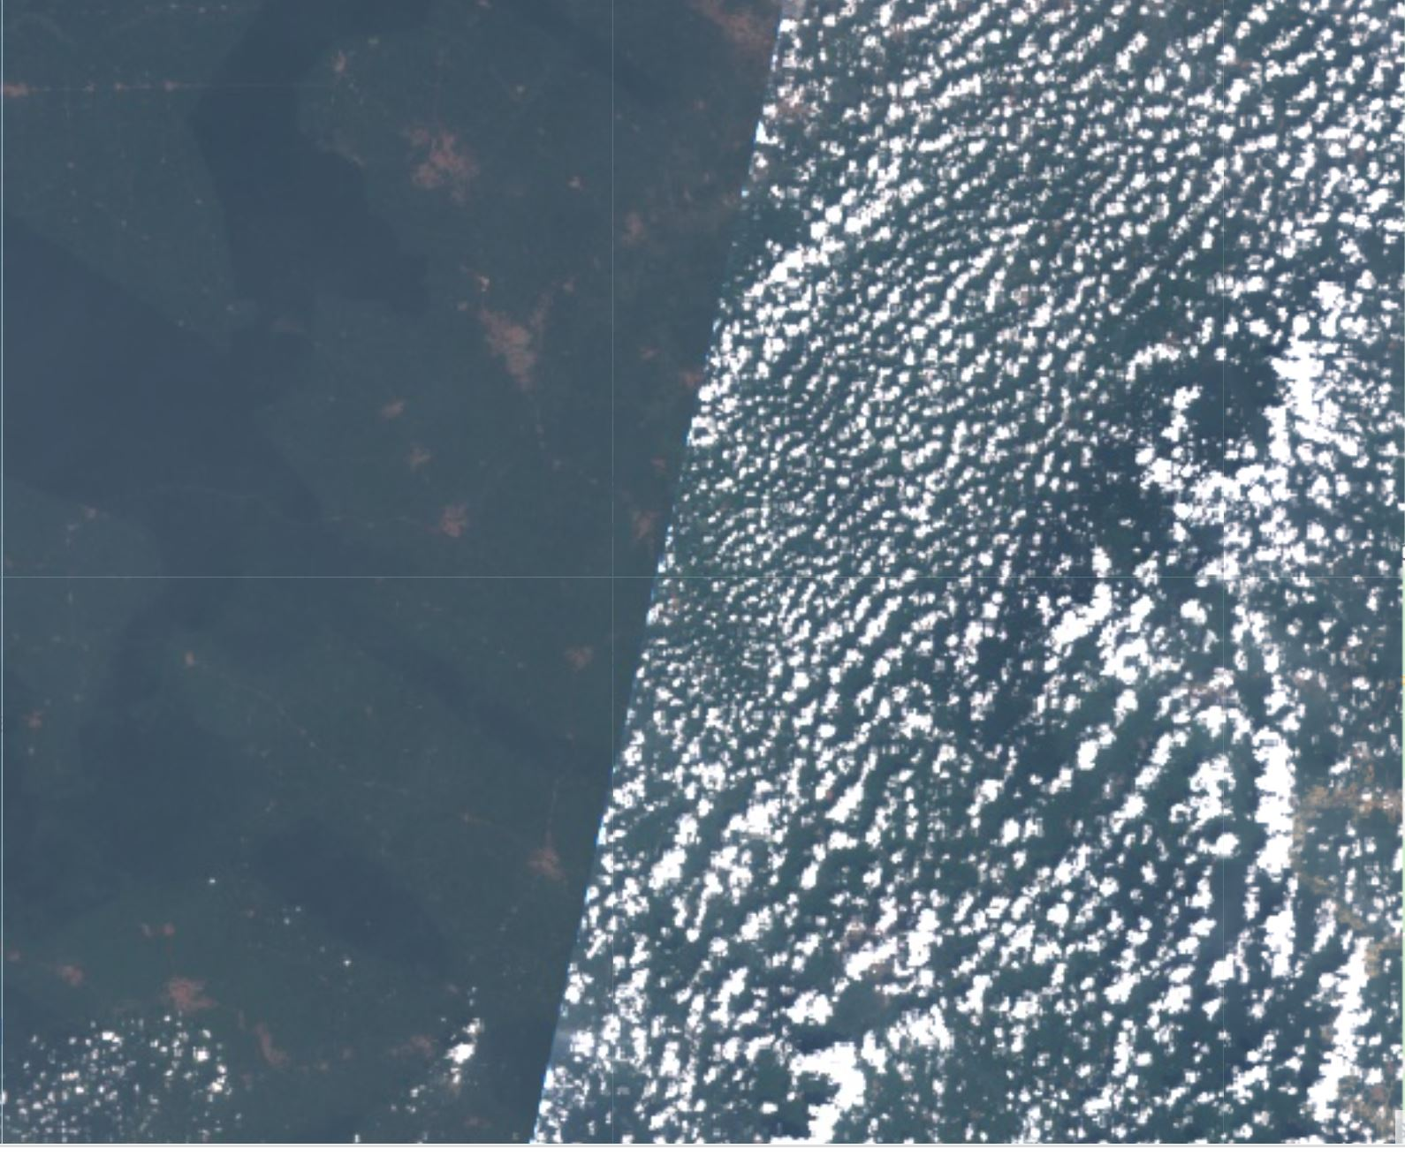
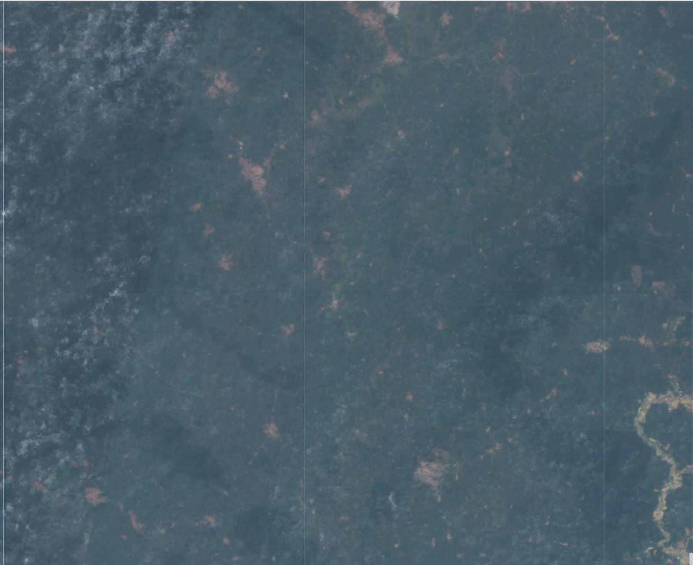
Visual Example of using the mosaic and the composite function on the same area and same date range
Mosaic
vrs
Composite

Slide 14
Run Script
Mosaicking and compositing Image Collection
Mosaicking Images

Slide 15
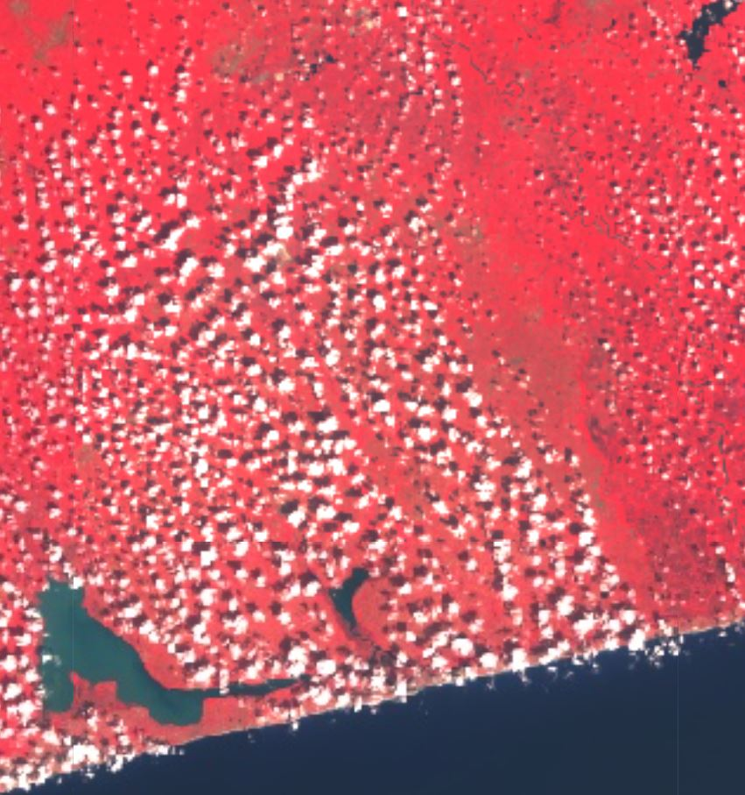
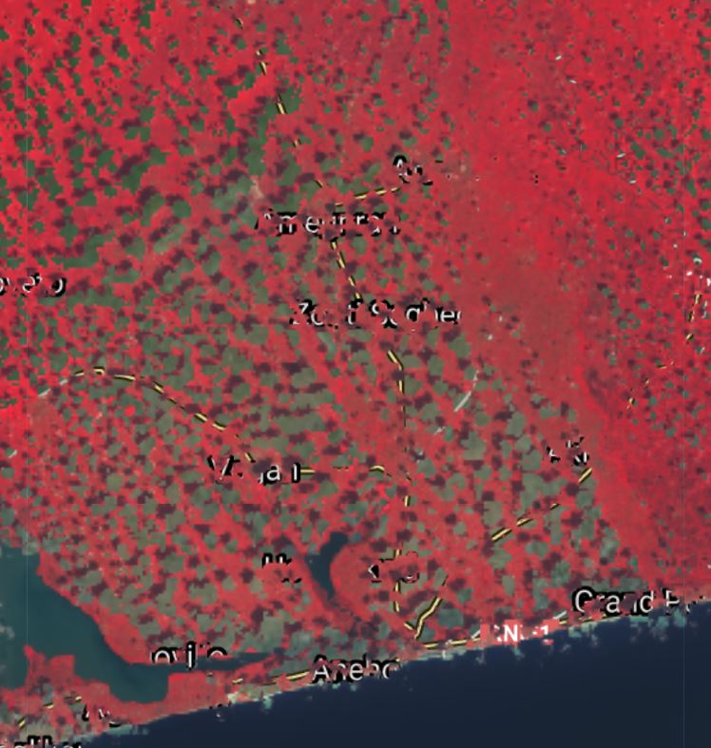
Cloud Masking
Cloud Masking

Slide 16
Feature and Feature Collection
A feature is an object that stores its geographical representation as a line, points and polygon
A FeatureCollection is a group of related features which enables additional operations on the entire set such as filtering, merging, clipping

Slide 17
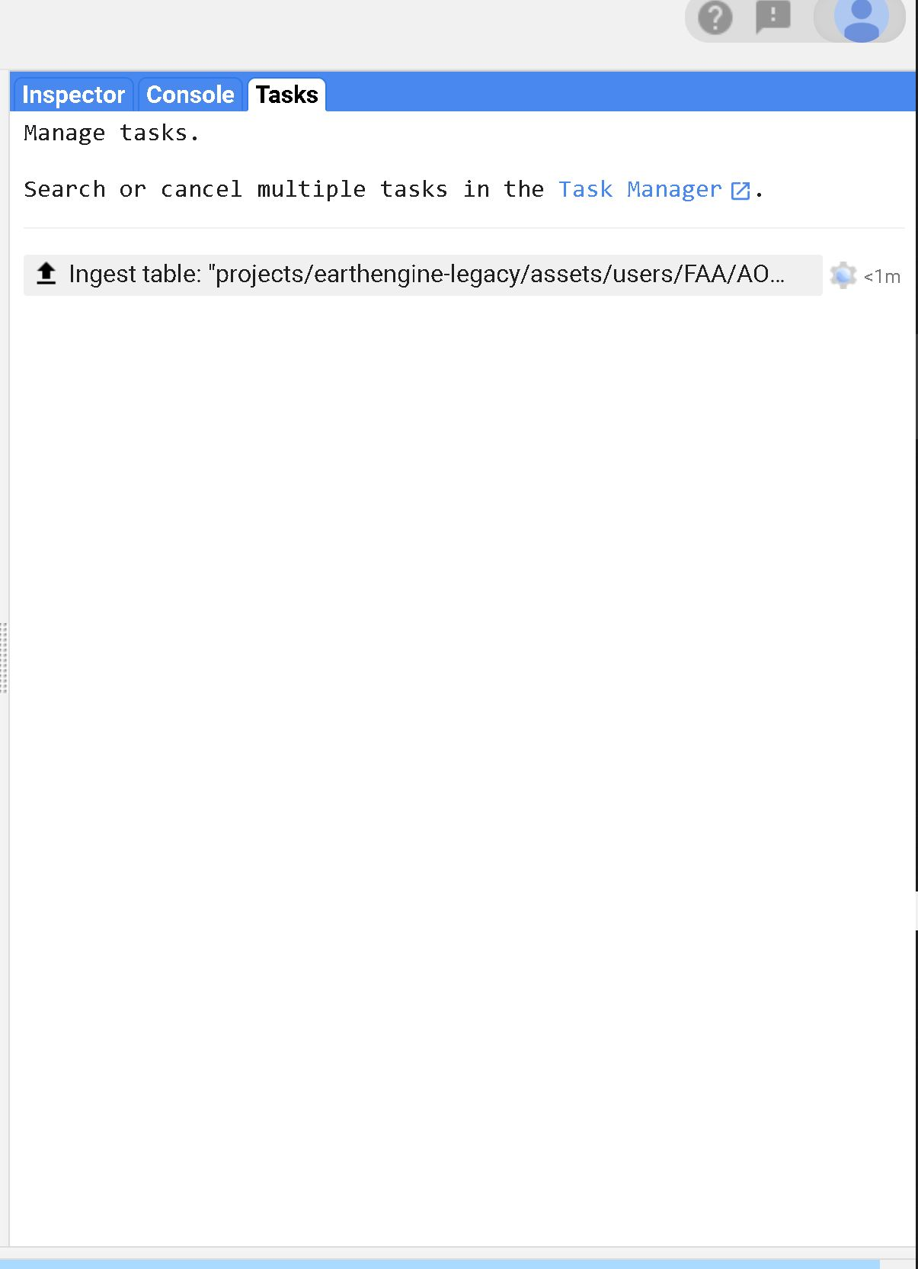
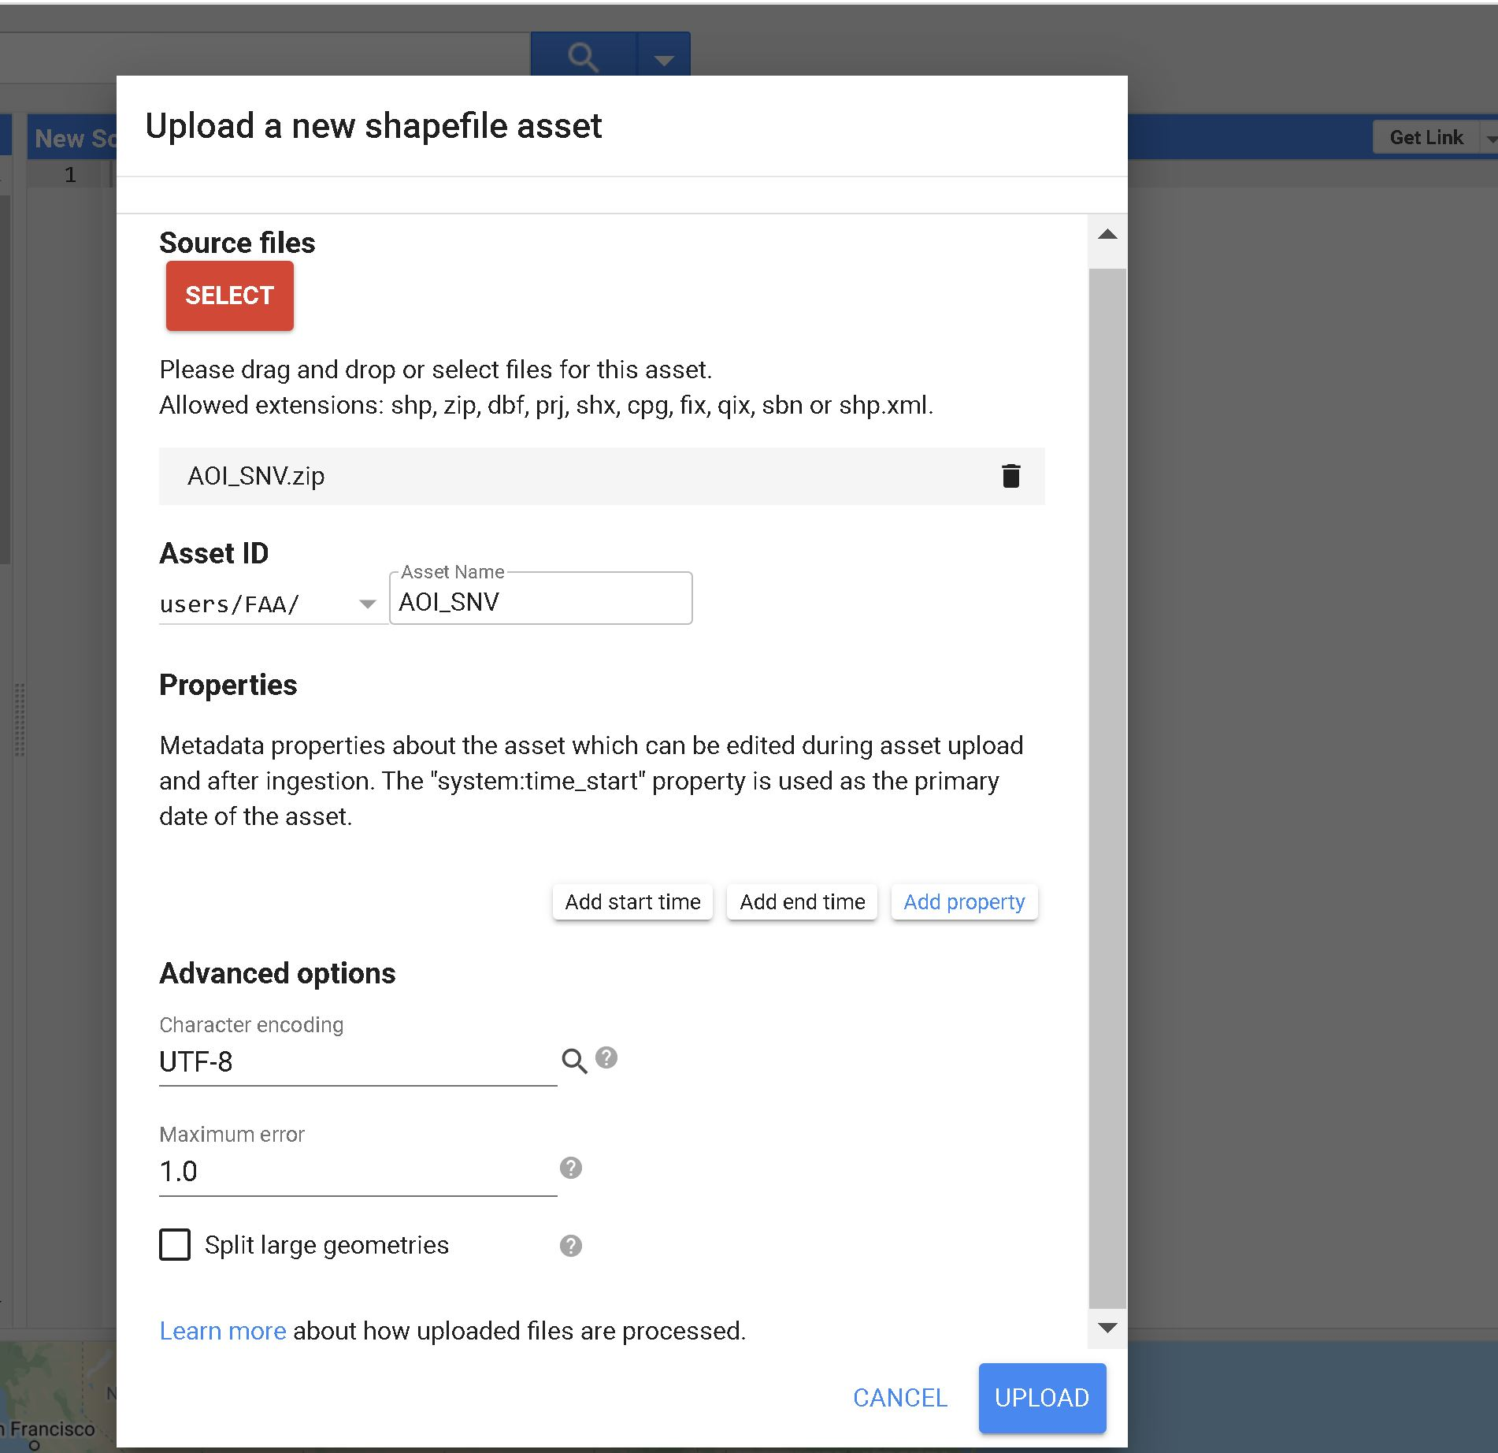
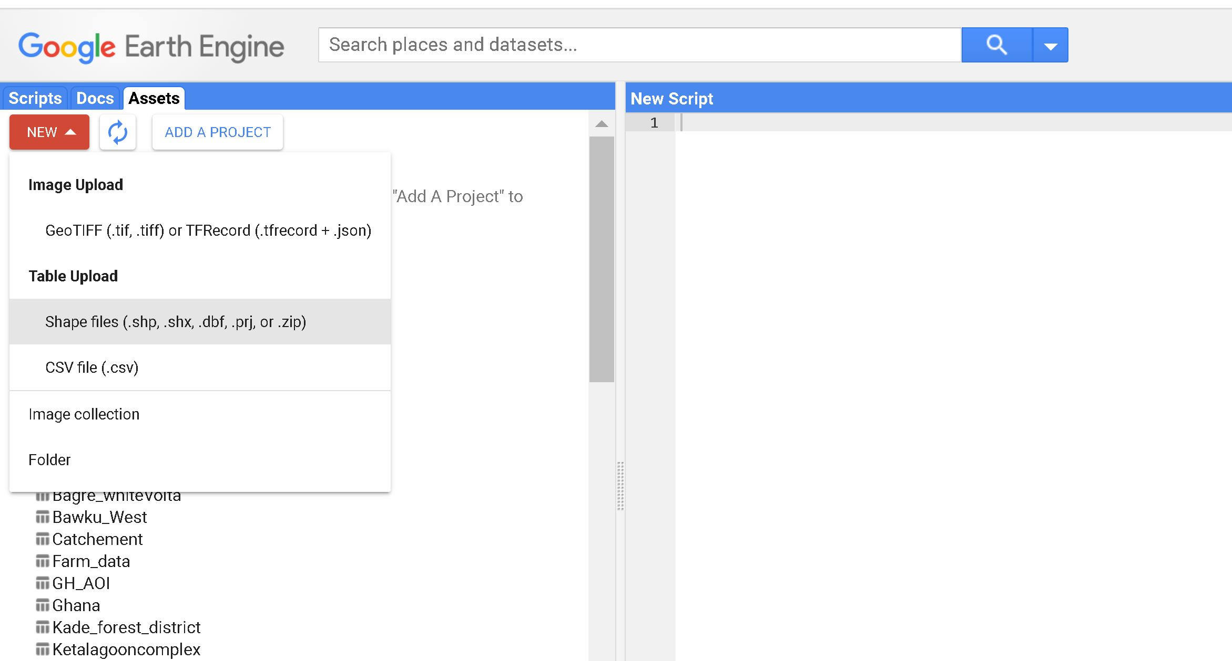
Importing a Feature/Feature Collection
Step1
click assets then click new
Step2
Upload the feature
Step3
Check uploading in the task bar

Slide 18
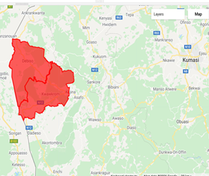
Display or visualizing Features
Display polygon feature
Example
var aoi = ee.FeatureCollection(users/FAA/District__Boundary_SNV/);
Map.addLayer(aoi, {'color': 'red'}, ' Districts of interest')
{} contains the visualization parameters

Slide 19
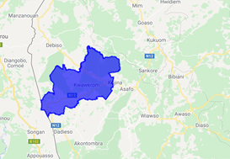
Query or filter Features
Filter specific district polygon
Example
//Filter Juabeso district from the districts of Interest
var Juabeso = aoi.filter(ee.Filter.eq('DISTRICT', 'JUABESO')
Map.addLayer(Juabeso, {'color': 'blue'}, ' Juabeso')

Slide 20
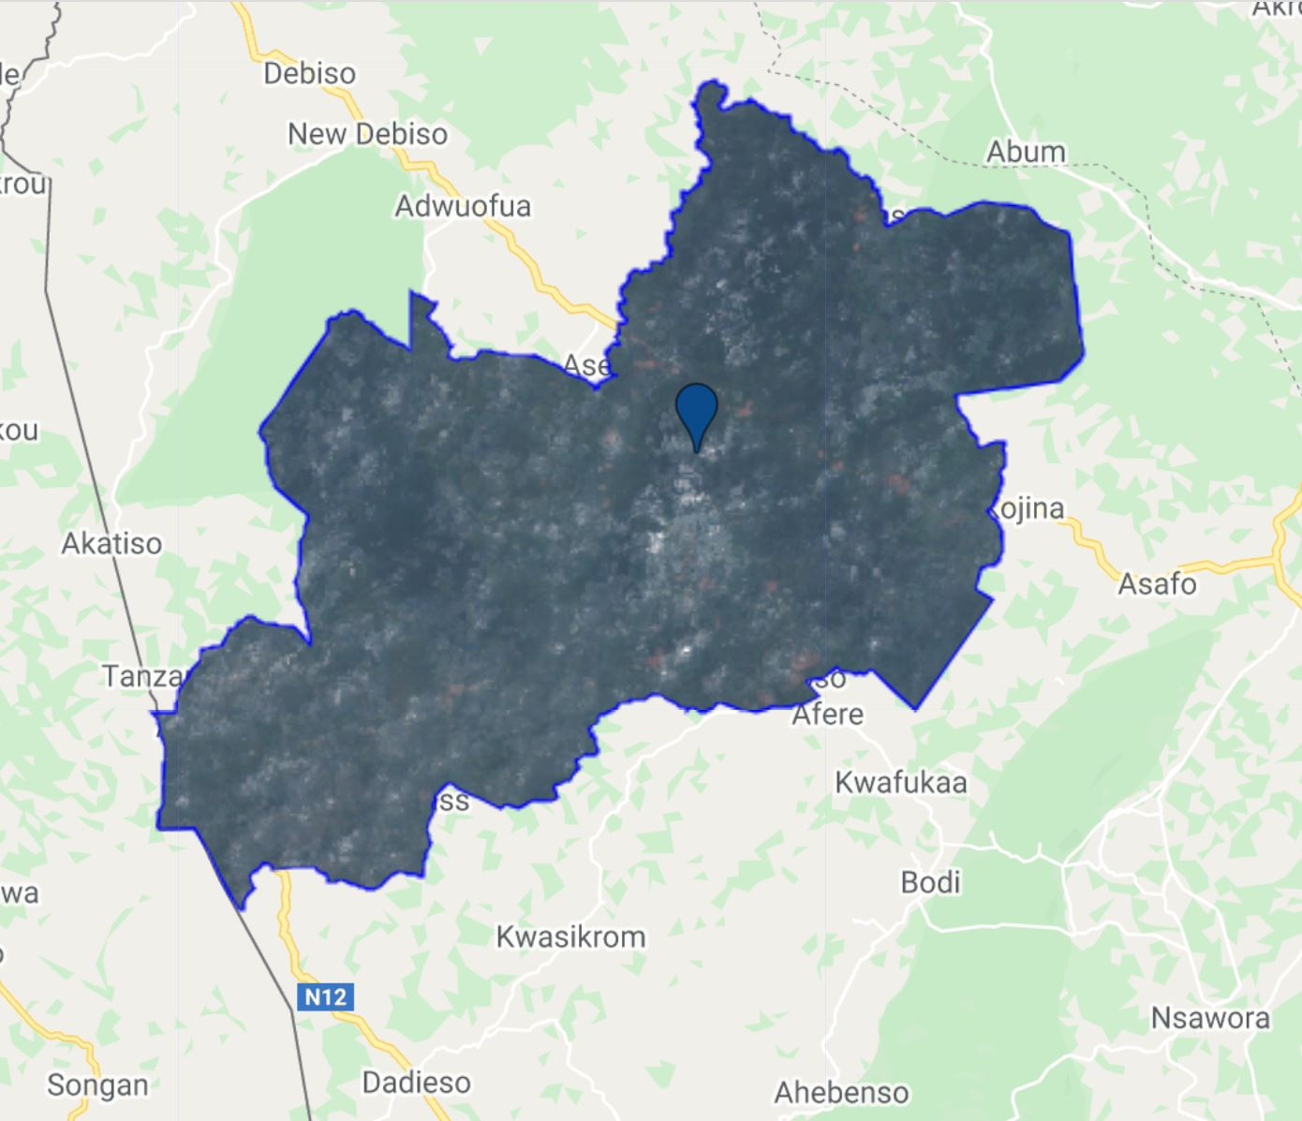
Clip Image/ImageCollection
Clip an image / image collection quried District of Interest
Example
// Clipping Function
var ClipImage =ImageCollection.clip(aoi);
var ClipImage=medianComposite.clip(Juabeso);

Slide 21
Run Script
Analysis on Feature/Feature Collection

Slide 22
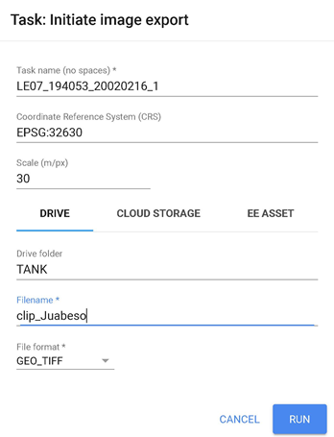
Export an Image Collection
Images can be exported as GeoTiFF
Example
// Export Image Collection to GeoTIFF
Export.image.toDrive({
image:clips.select('B2','B3','B4','B5','B6','B7'), // image bands to be exported
description: 'LE08_2017', // name of Image being Exported
region: table, // area of Interest
folder: 'TANK', //folder created in your google drive
scale: 30, //spatial resolution of output image
crs:'EPSG:32630', // coordinate System
maxPixels:1017604292451 //maximum allowed pixels to export
});
Run task to export image to local folder or cloud storage

Slide 23
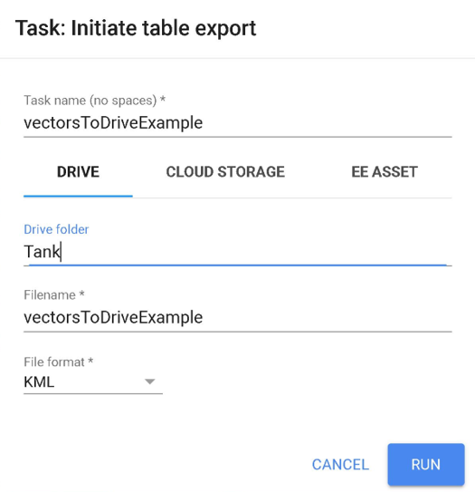
Export a Feature Collection
Features can be exported as KML or SHP
Example
// Export FeatureCollection to a KML file
Export.table.toDrive({
collection: features,
description:'vectorsToDriveExample',
fileFormat: 'KML'
});
Run task to export feature collection to local folder

Slide 24
Run Script
Exporting Image and Feature Collection

Slide 25
Hands-on Exercises
Exercise 1
Import Protected Areas into GEE
Filter/ Query Protected Areas in Bono and Bono East Region
Export the filtered Protected Areas as a shapefile
Exercise 2
Import Regional Boundary into GEE
Filter/ Query Bono Region
Create an Image Collection for Landsat 7 for 2020 covering Bono Region the area of interest
Clip the Image Collection with the filtered Regional Boundary(Bono)
Export the Clipped Image to GeoTIFF

Slide 26




Thank You
Accra, Ghana
September, 2021
Notes:
It's free for non-commercial use!

